Slide 1
Statistical Analysis I
Discrete Random Variables

Slide 2
Terminology
A RANDOM VARIABLE is a function that assigns a numerical value to each outcome of a sample space.
Examples: Political Affiliation (1 = Democrat, 2 = Republican, 3 = Other) for
All U.S. citizens of voting age
Product Status (1 = Shippable, ie, meets all specs, 0 = Not Shippable, ie, does not meet >= 1 spec) for
All product produced from a specific manufacturing line
Complaint Response Time for
All complaints made about airline travel
Number of “matches” (0, 1, 2, or 4) for
All possible ways 4 babies could be randomly assigned to 4 mothers
DISCRETE
DISCRETE
CONTINUOUS
DISCRETE
NOTE: The second example above is a special kind of Random Variable called a Bernoulli Trial.
A Bernoulli Trial is a Random Variable with only 2 outcomes – in the example, either
Product is Shippable or it is not – other examples include the following:
Examples: The face-up after tossing a coin (1 = Heads, 2 = Tails)
The answer to a True/False question on an exam (1 = True, 2 = False)
The color of an M&M is Brown (1 = Brown, 2 = Not Brown)
The gender of a medical patient (1 = Female, 2 = Male)
ALL
DISCRETE
NOTE: Three of the four initial examples above have a countable number of outcomes, but
Complaint Response Time does not – this time could be any value > 0.
A DISCRETE RANDOM VARIABLE is one involving a countable set of outcomes
A CONTINUOUS RANDOM VARIABLE is one involving an uncountable set of outcomes

Slide 3
Discrete Random Variables Probability Mass Functions
A Discrete PROBABILITY MASS FUNCTION (pmf) is a function f(x) such that
f_{X}(x) = P[X = x],
where x is a specific value (outcome) for Discrete Random Variable X.
Simply a function defining the probability of the specific outcome x.
Example: For tossing a coin, the Random Variable X = 0 if Tails & 1 if Heads
has pmf given by X(0) = ½ and X(1) = ½, or in chart form as:
x | 0 | 1
f_{X}(x) | ½ | ½
Example: For the exact matching of a random arrangement of the numbers 1, 2, 3, & 4, the Random Variable X = # Matches has pmf given by X(0) = 9/24, X(1) = 8/24, X(2) = 6/24, and X(4) = 1/24, or in chart form as:
x | 0 | 1 | 2 | 4
f_{X}(x) | 9/24 | 8/24 | 6/24 | 1/24

Slide 4
Discrete Random Variables Point Graphs and Histograms
Example: Tossing a Coin
Example: “Random 1,2,3,4” Matches

Slide 5
Discrete Random Variables Probability Mass Function Axioms and Summary
For any Discrete Probability Mass Function (pmf) given by f_{X}(x):
1) 0 <= f_{X}(x) <=1 for each value of x
2) Sum_{All values of x} { f_{X}(x) } = 1
Example: Tossing a Coin
Example: “Random 1,2,3,4” Matches
x | 0 | 1
f_{X}(x) | ½ | ½
x | 0 | 1 | 2 | 4
f_{X}(x) | 9/24 | 8/24 | 6/24 | 1/24
Sum = 1
Sum = 1
In summary, a discrete probability mass function consists of two elements:
1) some type of listing of all the possible values of the random variable, and
2) the corresponding probabilities for each value.

Slide 6
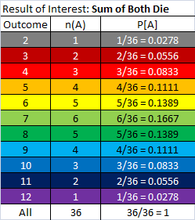

Discrete Random Variables Expected Value = Mean
The EXPECTED VALUE (or Mean) of a Discrete Random Variable X is given by:
µ = E[X] = Sum_{All values of x}{ x*f_{X}(x) }
Example: “Random 1,2,3,4” Matches
Example: Sum when Rolling 2 Die
x | 0 | 1 | 2 | 4
f_{X}(x) | 9/24 | 8/24 | 6/24 | 1/24
x*f_{X}(x) | 0 | 8/24 | 12/24 | 4/24
µ = Sum of Bottom Row
= (8 + 12 + 4)/24
= 24/24
= 1
Expected Value = Mean is simply
Sum of each of:
1) Outcome x (ie, “times”)
2) That Outcome’s
Probability of Occurring
µ = Sum of Last Column
= 252/36
= 7

Slide 7
Discrete Random Variables Expected Value = Center of Mass of Distribution
Example: “Random 1,2,3,4” Matches
Example: Sum when Rolling 2 Die
The EXPECTED VALUE is the point
at which the PMF would be expected
to “balance” as if on a fulcrum.
The MEAN as the “balancing” point is more obvious for this example, but is the Mean sufficient to describe a probability distribution?

Slide 8
Discrete Random Variables Measure of Spread = Variance
The VARIANCE of a Discrete Random Variable X is given by:
σ² = Var(X) = E[(x-µ)²]
= Sum_{All values of x}{ (x-µ)²*f_{X}(x) }
Example: “Random 1,2,3,4” Matches
x | 0 | 1 | 2 | 4
f_{X}(x) | 9/24 | 8/24 | 6/24 | 1/24
x*f_{X}(x) | 0 | 8/24 | 12/24 | 4/24
Expected Value = E[X] = µ = 1
(x-µ) | -1 | 0 | 1 | 3
(x-µ)² | 1 | 0 | 1 | 9
(x-µ)²f_{X}(x) | 9/24 | 0 | 6/24 | 9/24
Variance = Var(X) = 9/24 + 6/24 + 9/24 = 1 Standard Deviation = Sqrt[Var(X)] = 1
x | 0 | 1 | 2 | 4
f_{X}(x) | 9/24 | 8/24 | 6/24 | 1/24
x² | 0 | 1 | 4 | 16
x²*f_{X}(x) | 0 | 8/24 | 24/24 | 16/24
Variance = 8/24 + 24/24 + 16/24 – (1)² Var(X) = 48/24 – 1 = 2 – 1 = 1 (same as above)
Alternative formula for Variance:
σ² = Var(X)
= Sum_{All values of x}{ x²*f_{X}(x) } - µ²

Slide 9
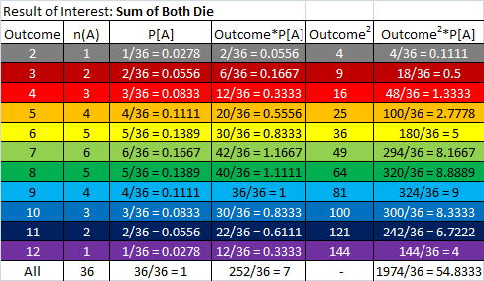
Discrete Random Variables Measure of Spread = Variance
Example: Sum when Rolling 2 Die
Expected Value = µ = 252/36 = 7
Variance = σ² = 1974/36 – (7)² = 54.8333 – 49 = 5.8333
Standard Deviation = σ = Sqrt(5.8333) = 2.4152

Slide 10
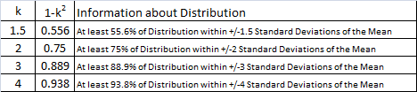
Using Standard Deviation
Chebyshev’s Theorem
For any random variable, X, with mean µ and standard deviation σ, then the probability that X lies within k standard deviations of the mean is
at least (1 – 1/k²), where k > 0, that is
P[ µ - kσ <= X <= µ + kσ] >= 1 – 1/k², k>0.
For k = 1, Chebyshev indicates:
P[ µ - 1σ <= X <= µ + 1σ] >= 1 – 1/1² = 0
So … no real information here, but for k>1:
1-k⁻²

Slide 11
Using Standard Deviation
Chebyshev’s Theorem
Example: “Random 1,2,3,4” Matches
P[ µ - 1σ <= X <= µ + 1σ] =
P[ 1 -1 <= X <= 1 + 1] =
P[ 0 <= X <= 2] =
9/24 + 8/24 + 6/24 =
23/24 = 0.9583 >= 0
P[ µ - 2σ <= X <= µ + 2σ] =
P[ 1 -2 <= X <= 1 + 2] =
P[ -1 <= X <= 3] =
9/24 + 8/24 + 6/24 =
23/24 = 0.9583 >= 0.75
x | 0 | 1 | 2 | 4
f_{X}(x) | 9/24 | 8/24 | 6/24 | 1/24
Mean = µ = 1
Standard Deviation = σ = 1
P[ µ - 3σ <= X <= µ + 3σ] =
P[ 1 -3 <= X <= 1 + 3] =
P[ -2 <= X <= 4] =
9/24 + 8/24 + 6/24 + 1/24 =
24/24 = 1 >= 0.889

Slide 12
Using Standard Deviation
Empirical Rule
For a “mounded” distribution,
P[µ - 1σ <= X <= µ + 1σ] ≈ 68%
P[µ - 2σ <= X <= µ + 2σ] ≈ 95%
P[µ - 3σ <= X <= µ + 3σ] ≈ 100%
Since “mounded” distributions are
Symmetric about their Mean:
P[µ <= X <= µ + σ] = P[µ - σ <= X <= µ] ≈ 34%
P[µ <= X <= µ + 2σ] = P[µ - 2σ <= X <= µ] ≈ 47.5%
P[µ <= X <= µ + 3σ] = P[µ - 3σ <= X <= µ] ≈ 50%
34%
34%
2.5%
2.5%
13.5%
13.5%

Slide 13
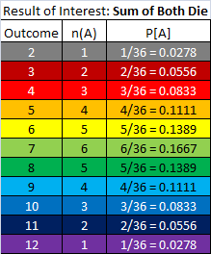
Using Standard Deviation
Empirical Rule
Example: Sum when Rolling 2 Die
P[ µ - 1σ <= X <= µ + 1σ] =
P[ 7 -2.145 <= X <= 7 + 2.145] =
P[ 4.855 <= X <= 9.145] =
4/36 + 5/36 + 6/36 + 5/36 + 4/36=
24/36 = 0.6667 ≈ 0.68
P[ µ - 2σ <= X <= µ + 2σ] =
P[ 7 – 4.29 <= X <= 7 + 4.29] =
P[ 2.71 <= X <= 11.29] =
2/36 + 3/36 + 24/36 + 3/36 + 2/36=
34/36 = 0.9444 ≈ 0.95
P[ µ - 3σ <= X <= µ + 3σ] =
P[ 7 – 6.435 <= X <= 7 + 6.435] =
P[ 0.565 <= X <= 13.435] =
1/36 + 34/36 + 1/36=
36/36 = 1 = 1
µ = 7
σ = 2.145

Slide 14
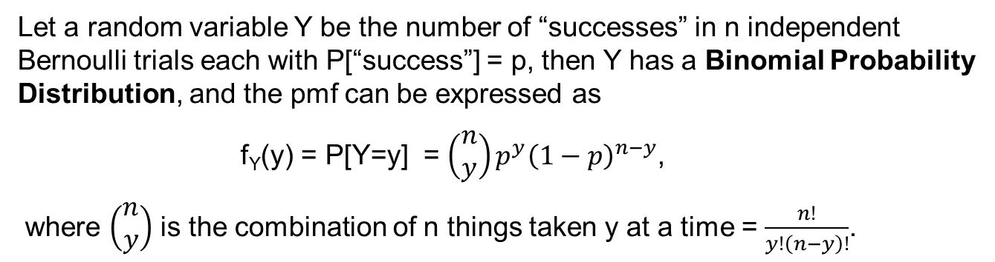
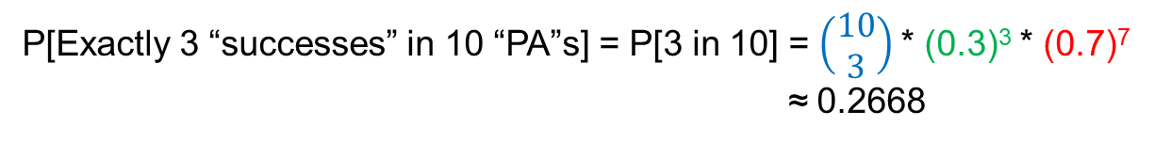
Binomial Probability Distribution
Let a random variable Y be the number of “successes” in n independent
Bernoulli trials each with P[“success”] = p, then Y has a Binomial Probability
Distribution, and the pmf can be expressed as
f_{Y}(y) = P[Y=y] = $\left(\begin{matrix}n \\ y\end{matrix}\right)p^{y}{\left(1−p\right)}^{n−y}$,
where $\left(\begin{matrix}n \\ y\end{matrix}\right)$ is the combination of n things taken y at a time = $\frac{n!}{y!\left(n−y\right)!}$.
Example: Consider a baseball player who has a lifetime on-base percentage of 0.300.
This means he is “successful” in reaching at least 1st base in 30% of his “plate appearances” (ie, “PA’s = “trials”).
In each “plate appearance” he is either “successful” in getting “on-base”, or not, these are Bernoulli
trials (recall – a Bernoulli random variable is one with only 2 outcomes – “on-base” or “not on-base” = “out” in this case).
So in 10 “plate appearances” (ie, “trials”) what is the probability this player reaches at least 1st base (ie, a “success”) exactly 3 times?
P[ Exactly 3 “successes” in 10 “PA”s ] = P[ 3 “successes (s)” and 7 “outs (f)” in 10 “PA”s]
P[“on-base” = “success” on a single “PA”] = 0.3
P[“out” = “failure” on a single “PA”] = 1 – 0.3 = 0.7
Occurs 3 times, so P[S = 3 in 3] = (0.3)³
Occurs 7 times, so P[F= 7 in 7] = (0.7)⁷
Number of ways to arrange 3 Ss & 7 Fs is 10!/(3!*7!) = $\left(\begin{matrix}10 \\ 3\end{matrix}\right)$, so …
P[Exactly 3 “successes” in 10 “PA”s] = P[3 in 10] = $\left(\begin{matrix}10 \\ 3\end{matrix}\right)$* (0.3)³ * (0.7)⁷
≈ 0.2668

Slide 15
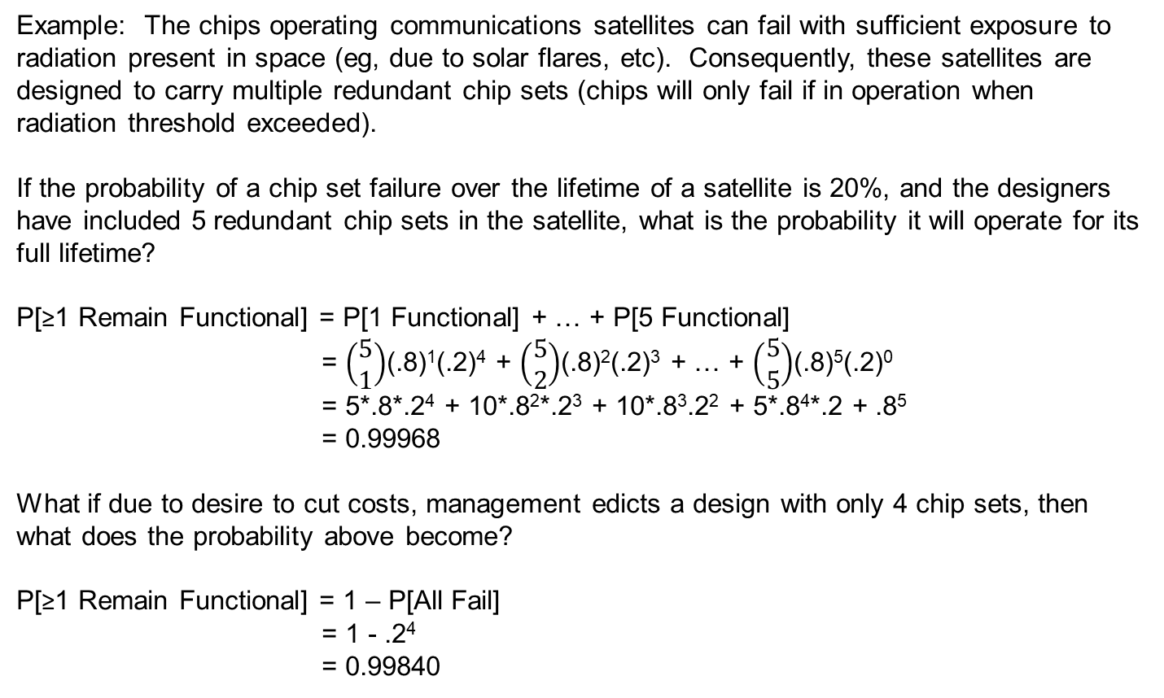
Binomial Probability Distribution
Example: The chips operating communications satellites can fail with sufficient exposure to radiation present in space (eg, due to solar flares, etc). Consequently, these satellites are designed to carry multiple redundant chip sets (chips will only fail if in operation when radiation threshold exceeded).
If the probability of a chip set failure over the lifetime of a satellite is 20%, and the designers have included 5 redundant chip sets in the satellite, what is the probability it will operate for its full lifetime?
P[≥1 Remain Functional] = P[1 Functional] + … + P[5 Functional]
= $\left(\begin{matrix}5 \\ 1\end{matrix}\right)$(.8)¹(.2)⁴ + $\left(\begin{matrix}5 \\ 2\end{matrix}\right)$(.8)²(.2)³ + … + $\left(\begin{matrix}5 \\ 5\end{matrix}\right)$(.8)⁵(.2)⁰
= 5*.8*.2⁴ + 10*.8²*.2³ + 10*.8³.2² + 5*.8⁴*.2 + .8⁵
= 0.99968
What if due to desire to cut costs, management edicts a design with only 4 chip sets, then what does the probability above become?
P[≥1 Remain Functional] = 1 – P[All Fail]
= 1 - .2⁴
= 0.99840

Slide 16
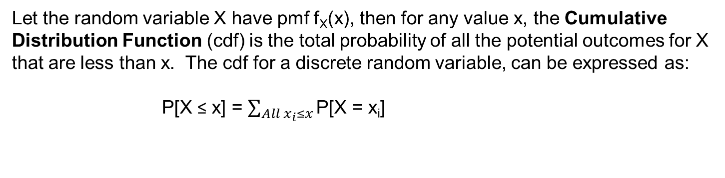
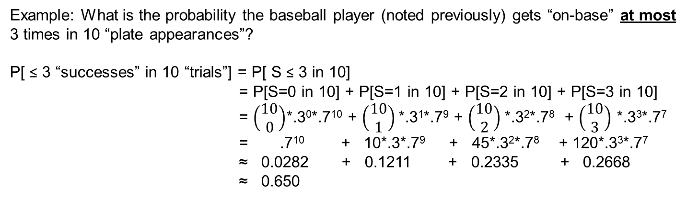
Binomial Probability Distribution
Let the random variable X have pmf f_{X}(x), then for any value x, the Cumulative Distribution Function (cdf) is the total probability of all the potential outcomes for X that are less than x. The cdf for a discrete random variable, can be expressed as:
P[X ≤ x] = $\sum_{All x_{i}≤x}{\text{P}\text{[}\text{X}\text{ = }\text{xi}\text{]}}$
Example: What is the probability the baseball player (noted previously) gets “on-base” at most 3 times in 10 “plate appearances”?
P[ ≤ 3 “successes” in 10 “trials”] = P[ S ≤ 3 in 10]
= P[S=0 in 10] + P[S=1 in 10] + P[S=2 in 10] + P[S=3 in 10]
= $\left(\begin{matrix}10 \\ 0\end{matrix}\right)$*.3⁰*.7¹⁰ + $\left(\begin{matrix}10 \\ 1\end{matrix}\right)$*.3¹*.7⁹ + $\left(\begin{matrix}10 \\ 2\end{matrix}\right)$*.3²*.7⁸ + $\left(\begin{matrix}10 \\ 3\end{matrix}\right)$ *.3³*.7⁷
= .7¹⁰ + 10*.3*.7⁹ + 45*.3²*.7⁸ + 120*.3³*.7⁷
≈ 0.0282 + 0.1211 + 0.2335 + 0.2668
≈ 0.650
Note: There is an Excel function that calculates Binomial probabilities:
=BINOMDIST(x, n, p, False/True),
where x = number of successes of interest,
n = number of trials considered,
p = probability of success involved, with
False = P[Exactly x successes in n trials] (pmf) and
True = P[At Most x successes in n trials] (cdf)

Slide 17
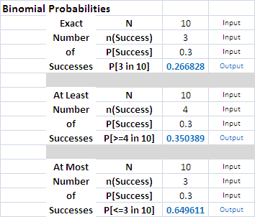
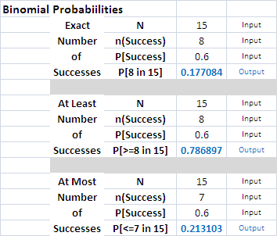
Binomial Probability Distribution
OR … we could just use an Excel utility to do this for us:
Requires 3 Inputs:
1) N = Number of “Trials” (ie, n)
2) n(Success) = Number of “Successes” (ie, x)
3) P[Success] = Probability of “Success” (ie, p)
Note requires Input for the specific Probability of Interest:
Exact (ie, P[3 in 10]),
At Least (ie, P[>=4 in 10], or
At Most (ie. P[<=3 in 10]
Example: X ~ Bin(n=15, p = 0.6)
a) P[X = 8] = ?
b) P[X < 8] = ?
c) P[X >= 8] = ?

Slide 18
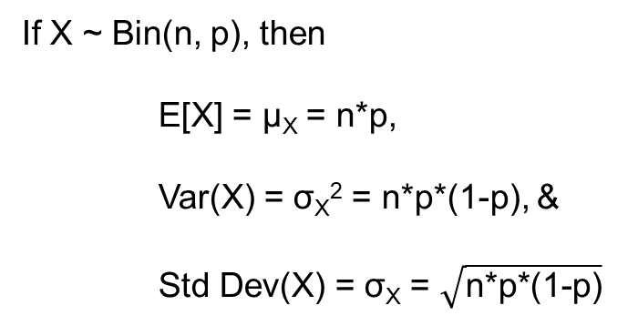
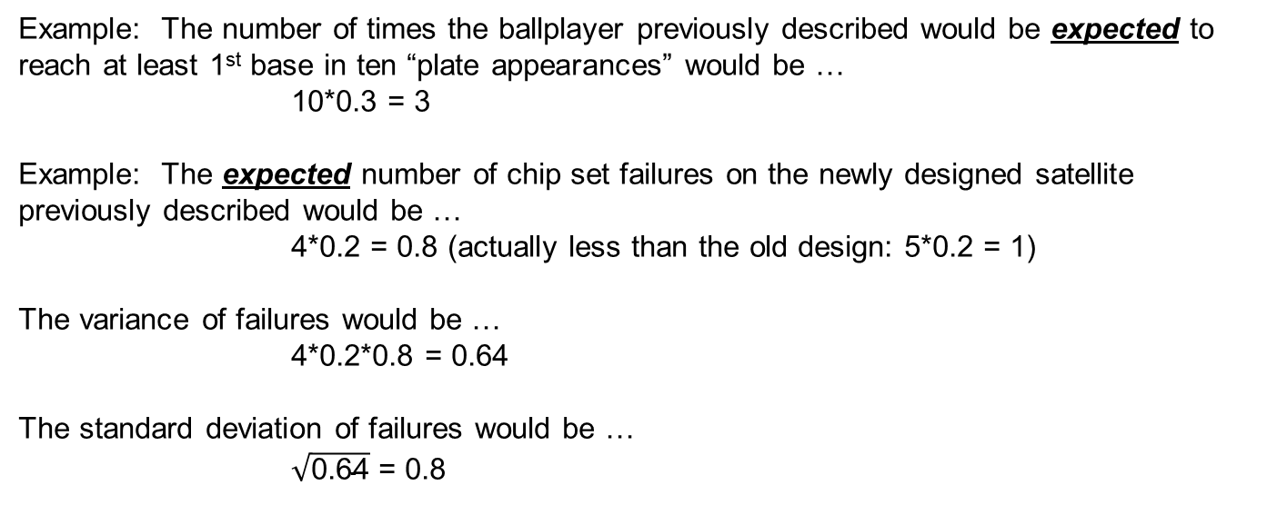
Binomial Probability Distribution
Mean, Variance, & Standard Deviation
If X ~ Bin(n, p), then
E[X] = μ_{X} = n*p,
Var(X) = σ_{X}² = n*p*(1-p), &
Std Dev(X) = σ_{X} = $\sqrt{\text{n}\text{∗}\text{p}\text{∗(1−}\text{p}\text{)}}$
Example: The number of times the ballplayer previously described would be expected to reach at least 1st base in ten “plate appearances” would be …
10*0.3 = 3
Example: The expected number of chip set failures on the newly designed satellite previously described would be …
4*0.2 = 0.8 (actually less than the old design: 5*0.2 = 1)
The variance of failures would be …
4*0.2*0.8 = 0.64
The standard deviation of failures would be …
$\sqrt{\text{0.64}}$ = 0.8

Slide 19
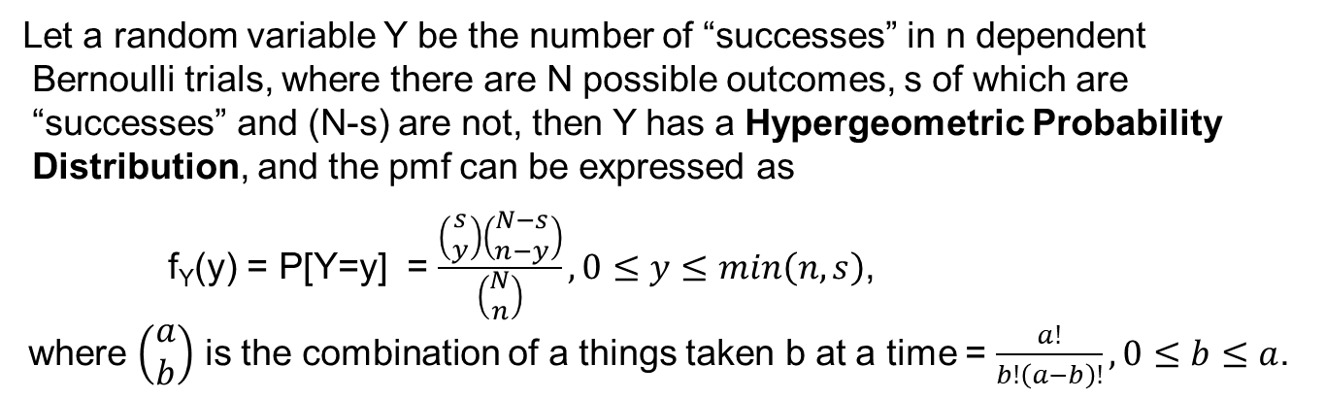
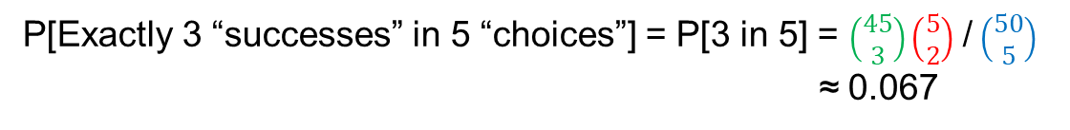

Hypergeometric Probability Distribution
Let a random variable Y be the number of “successes” in n dependent
Bernoulli trials, where there are N possible outcomes, s of which are
“successes” and (N-s) are not, then Y has a Hypergeometric Probability
Distribution, and the pmf can be expressed as
f_{Y}(y) = P[Y=y] = $\frac{\left(\begin{matrix}s \\ y\end{matrix}\right)\left(\begin{matrix}N−s \\ n−y\end{matrix}\right)}{\left(\begin{matrix}N \\ n\end{matrix}\right)}, 0≤y≤min\left(n,s\right)$,
where $\left(\begin{matrix}a \\ b\end{matrix}\right)$ is the combination of a things taken b at a time = $\frac{a!}{b!\left(a−b\right)!}, 0≤b≤a$.
Example: You are throwing a party and need to purchase 5 dozen eggs. There are 50 cartons each with a dozen eggs at the store, but unbeknownst to you, 5 of these have at least one broken egg.
You are “successful” if you choose a carton with no broken eggs, but your P[“success”] changes after each choice you make (ie, put a carton in your cart).
Each “choice” you are either “successful” in getting no broken eggs, or not, so these are Bernoulli
trials (recall – a Bernoulli random variable is one with only 2 outcomes – “0 broken” or “>=1 broken” in this case), but they are NOT independent since the P[“0 broken”] changes with each choice/trial.
So in choosing 5 cartons (ie, trials”) what is the probability you end up with exactly 2 cartons with some broken eggs?
Number of ways to choose 2 damaged cartons from the 5 available
Number of ways to choose 3 cartons from the 45 undamaged ones
$\left(\begin{matrix}5 \\ 2\end{matrix}\right)$ = 5!/(2!*3!)
$\left(\begin{matrix}45 \\ 3\end{matrix}\right)$ = 45!/(3!*42!)
Number of ways to choose any 5 cartons from the 50 available = $\left(\begin{matrix}50 \\ 5\end{matrix}\right)$ = 50!/(5!*45!), so …
P[Exactly 3 “successes” in 5 “choices”] = P[3 in 5] = $\left(\begin{matrix}45 \\ 3\end{matrix}\right)\left(\begin{matrix}5 \\ 2\end{matrix}\right)$ / $\left(\begin{matrix}50 \\ 5\end{matrix}\right)$
≈ 0.067

Slide 20
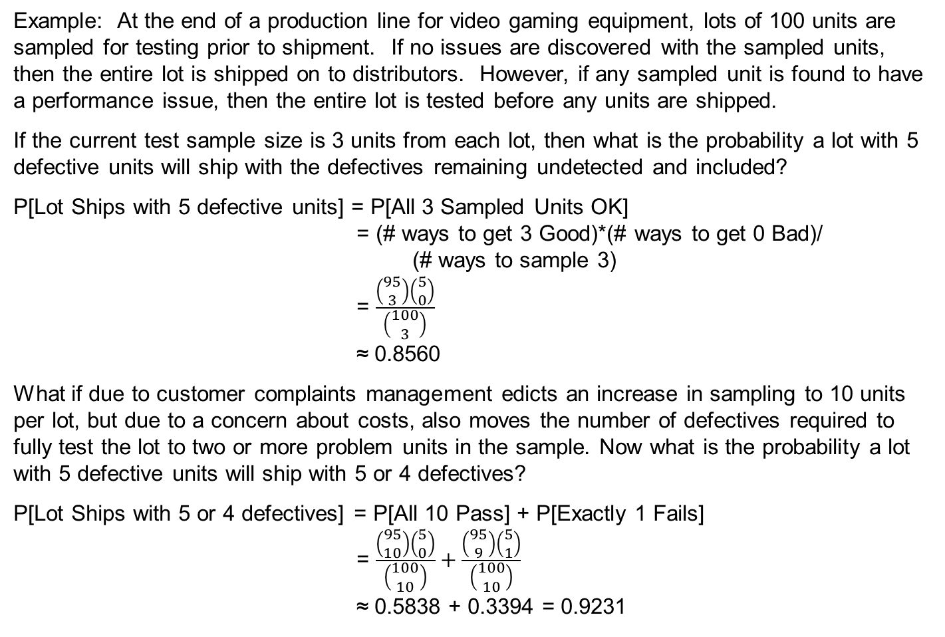
Hypergeometric Probability Distribution
Example: At the end of a production line for video gaming equipment, lots of 100 units are sampled for testing prior to shipment. If no issues are discovered with the sampled units, then the entire lot is shipped on to distributors. However, if any sampled unit is found to have a performance issue, then the entire lot is tested before any units are shipped.
If the current test sample size is 3 units from each lot, then what is the probability a lot with 5 defective units will ship with the defectives remaining undetected and included?
P[Lot Ships with 5 defective units] = P[All 3 Sampled Units OK]
= (# ways to get 3 Good)*(# ways to get 0 Bad)/
(# ways to sample 3)
= $\frac{\left(\begin{matrix}95 \\ 3\end{matrix}\right)\left(\begin{matrix}5 \\ 0\end{matrix}\right)}{\left(\begin{matrix}100 \\ 3\end{matrix}\right)}$
≈ 0.8560
What if due to customer complaints management edicts an increase in sampling to 10 units per lot, but due to a concern about costs, also moves the number of defectives required to fully test the lot to two or more problem units in the sample. Now what is the probability a lot with 5 defective units will ship with 5 or 4 defectives?
P[Lot Ships with 5 or 4 defectives] = P[All 10 Pass] + P[Exactly 1 Fails]
= $\frac{\left(\begin{matrix}95 \\ 10\end{matrix}\right)\left(\begin{matrix}5 \\ 0\end{matrix}\right)}{\left(\begin{matrix}100 \\ 10\end{matrix}\right)}+\frac{\left(\begin{matrix}95 \\ 9\end{matrix}\right)\left(\begin{matrix}5 \\ 1\end{matrix}\right)}{\left(\begin{matrix}100 \\ 10\end{matrix}\right)}$
≈ 0.5838 + 0.3394 = 0.9231

Slide 21

Hypergeometric Probability Distribution
So is management … misguided?
Well … lets look a little more closely …
Lets consider the following table:
So … slightly less
expected defectives
per lot
And … slightly less
expected units tested
per lot
But … slightly higher
expected percentage
of defectives shipped
So … change is really just about a “wash” (ie, not really different than before),
But … management looks like it is doing something ☺

Slide 22
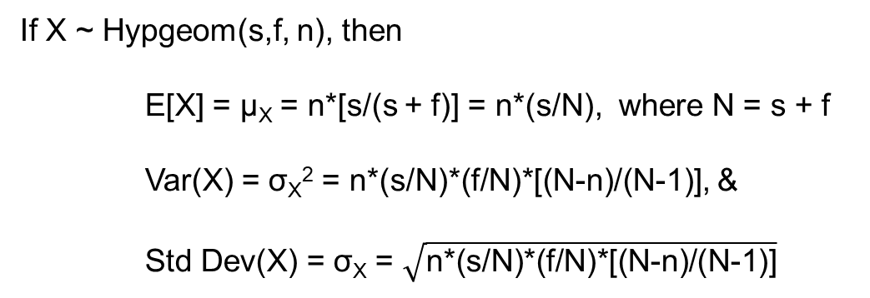
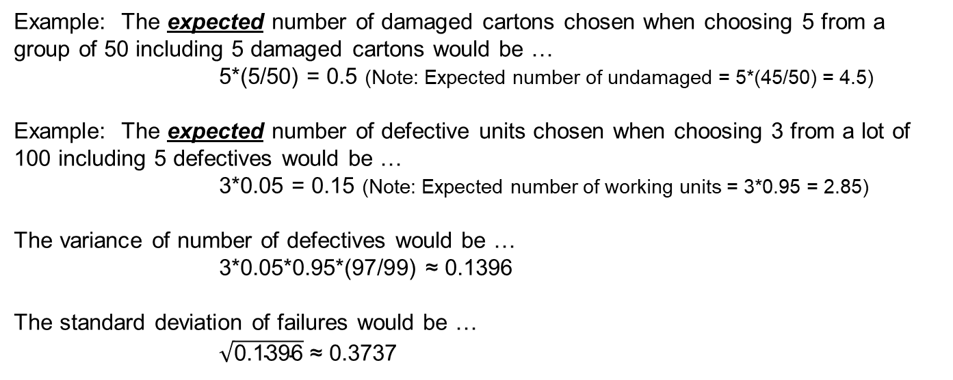
Hypergeometric Probability Distribution
Mean, Variance, & Standard Deviation
If X ~ Hypgeom(s,f, n), then
E[X] = μ_{X} = n*[s/(s + f)] = n*(s/N), where N = s + f
Var(X) = σ_{X}² = n*(s/N)*(f/N)*[(N-n)/(N-1)], &
Std Dev(X) = σ_{X} = $\sqrt{\text{n}\text{∗(}\text{s}\text{/}\text{N}\text{)∗(}\text{f}\text{/}\text{N}\text{)∗[(}\text{N}\text{−}\text{n}\text{)/(}\text{N}\text{−1)]}}$
Example: The expected number of damaged cartons chosen when choosing 5 from a group of 50 including 5 damaged cartons would be …
5*(5/50) = 0.5 (Note: Expected number of undamaged = 5*(45/50) = 4.5)
Example: The expected number of defective units chosen when choosing 3 from a lot of 100 including 5 defectives would be …
3*0.05 = 0.15 (Note: Expected number of working units = 3*0.95 = 2.85)
The variance of number of defectives would be …
3*0.05*0.95*(97/99) ≈ 0.1396
The standard deviation of failures would be …
$\sqrt{\text{0.1396}}$ ≈ 0.3737

Slide 23
Poisson Distribution
One of the stories surrounding the development of the Poisson distribution is that it was developed by a Frenchman (Poisson) as part of a study of the frequency of horses killing soldiers in the process of re-shoeing them during the Napoleonic wars.
Recall that e^{x} = 1 + x + x²/2! + x³/3! + … = ∑_{k=0 to ∞} x^{k}/k!,
so p(x) = λ^{x}e^{-λ}/x!, x = 0, 1, … defines a pmf for a random variable X, and
such a pmf is called a Poisson pmf with parameter λ.
Random variables that have Poisson pmfs not only include the number of soldiers kicked in the head by their horses. Such random variables tend to appear in other situations as well:
number of accidents occurring in a given space and time,
number of defectives produced for a given process over a given amount of time,
number of defects on a given product,
number of calls received at a given telephone number over a given period of time,
number of customers entering a place of business for a given period of time.
There are generally three postulates that give rise to Poisson processes:
The probability of an occurrence of interest actually occurring in a fixed time interval of length t is approximately proportional to the length of the interval (ie, ≈λt, where λt is the parameter of the respective Poisson pmf)
The probability of 2 or more occurrences in this interval is essentially zero.
Occurrences in non-overlapping intervals are mutually independent of each other.

Slide 24
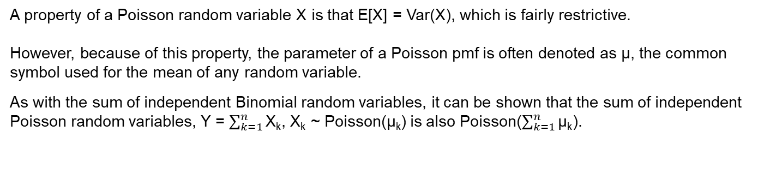
Poisson Distribution
A property of a Poisson random variable X is that E[X] = Var(X), which is fairly restrictive.
However, because of this property, the parameter of a Poisson pmf is often denoted as μ, the common symbol used for the mean of any random variable.
As with the sum of independent Binomial random variables, it can be shown that the sum of independent Poisson random variables, Y = $\sum_{k=1}^{n}{\text{X}\text{k}}$, X_{k} ~ Poisson(μ_{k}) is also Poisson($\sum_{k=1}^{n}{\text{μ}\text{k}}$).
Example: Assume that the number of passes thrown by Patrick Mahomes in a specific game has a Poisson pmf. Then the pmf can be expressed as:
p(x) = e^{-μ}μ^{x}/x!, x = 0, 1, …
As of 9/20/23, Mahomes had thrown 3,596 passes in 96 regular season games, an average of ~34 per game.
So, setting μ = 34 (large for most Poisson applications), an estimate of the probability that Mahomes will throw 20 passes in his next game would be given as
P[X = 20] = e⁻³⁴*(34)²⁰/20! ≈ 0.003
Clearly, some of these values are large (eg, 20! ≈ 2.433 x 10¹⁸), so such probabilities are generally obtained via computer. As with the Binomial distribution, there is also an Excel function for the Poisson distribution: =POISSON(x, μ, T/F) where x is the number of occurrences of interest, μ is the applicable Poisson parameter, and T/F, as for the Binomial, is FALSE for the pmf values and TRUE for the cdf results.

Slide 25
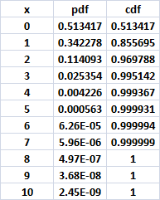
Poisson Distribution
Example (continued): So the probability Mahomes throws 20 passes in his next game is approximately 3 in 1000.
A more interesting probability might be
P[Mahomes throws fewer than 20 passes in his next game] = P[X < 20] ≈ 0.00675
This is still small, and the probability of real interest to a bettor and more important to his bookie would be the number of passes k where P[X < k] ≈ P[X > k] ≈ 0.5, as the value of k represents a reasonable value at which to set a standard over-under bet.
It turns out for the assumptions made here, k = 34 results in P[X < 34] ≈ 0.477 & P[X > 34] ≈ 0.455.
Does it make sense that k = 34 is near the median of this distribution?
Would it be expected that the median of any Poisson(μ) random variable would be = μ?
Why might it be expected in this case?

Slide 26
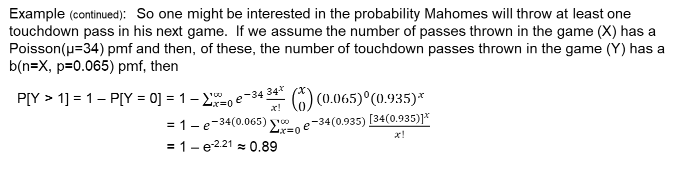
Poisson Distribution
Example (continued): So one might be interested in the probability Mahomes will throw at least one touchdown pass in his next game. If we assume the number of passes thrown in the game (X) has a Poisson(μ=34) pmf and then, of these, the number of touchdown passes thrown in the game (Y) has a b(n=X, p=0.065) pmf, then
P[Y > 1] = 1 – P[Y = 0] = 1 – $\sum_{x=0}^{∞}{e^{−34}\frac{{34}^{x}}{x!}} \left(\begin{matrix}x \\ 0\end{matrix}\right){\left(0.065\right)}^{0}{\left(0.935\right)}^{x}$
= 1 – $e^{−34(0.065)}\sum_{x=0}^{∞}{e^{−34(0.935)}\frac{{[34\left(0.935\right)]}^{x}}{x!}}$
= 1 – e^{-2.21} ≈ 0.89
Again, to set a reasonable value for an over-under bet on the number of touchdown passes Mahomes will throw in his next game, it would be desirable to know k where
P[Y < k] ≈ P[Y > k] ≈ 0.5
The marginal pmf for Y is Poisson(μ=34*0.065=2.21), and the pmf for Y is as seen below:
So where does the bookie set the over-under value?
If set at Y=2, then if Mahomes throws 2 TD passes, no one wins. The chances of this occurring appear to be ~ 1 in 4.
However, the bookie’s exposure is approximately the same on either side of the bet, as P[Under Wins] = 0.3521 and P[Over Wins] = 0.38.
Mahomes threw 33 passes of which 3 were touchdown passes in his next game in win vs Bears (“Over” wins).

Slide 27
Continuous Probability Density Function
While Discrete Random Variables have a Probability Mass Function (pmf), the
differences between countable and uncountable sets (recall – discrete random variables are defined on countable sets, continuous on uncountable sets) no longer allow the use of a pmf.
Instead, for Continuous Random Variables, we utilize a Probability Density Function (pdf). Let X be a continuous random variable with pdf f_{X}(x) , then
1) f_{X}(x) >= 0 for all applicable values x,
2) P[ a <= X <= b] is the area under the graph of f_{X}(x) for
the interval [a, b], and
3) the total area under the graph of f_{X}(x) = 1.

